Slide 1
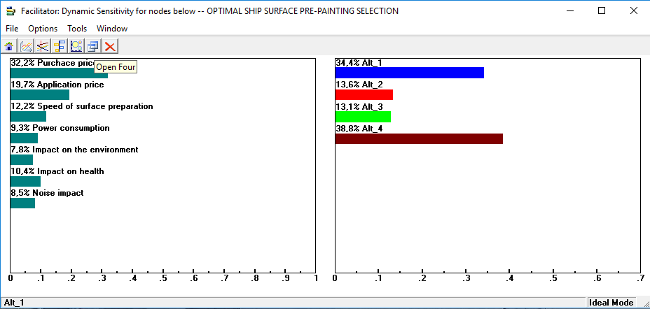
8th International Conference on Marine Technology – WINKLER 2019 – Rijeka – Croatia
TITLE
Surname, Name 1; , Surname, Name 2; etc
Abstract
2.1. Subtitle
Text
Text
1. Introduction
$$∆=\frac{δy}{δx}, (1)$$
Text
Results and Conclusion
Text
2. Title
Text
Figure 1. Title
Text
Literature
[1] Text
Table 1. Title
ROW 1
ROW 2
Text
Acknowledgements
Text
YOUR INSTITUTION LOGO
Contacts
Author, adress, e-mail
Author, adress, e-mail
etc.

